Slide 1
WELCOME
Class: B.Com – Part-1
Subject: Financial Accounting
TOPIC: ACCOUNTING PRINCIPLES
Prepared By
Dr. SHAHID IQBAL
Guest Faculty,
Marwari College, Darbhanga,
Mobile No. and Whatsup No. : 7004160257
Email ID: shahidlnmu@gmail.com

Slide 2
MEANING OF ACCOUNTING PRINCIPLES
Principle means the fundamental truth implying uniformity of acceptance everywhere. However, the word ‘principle’, when applied in accounting, may have different context. It is rarely used in the sense of a fundamental accounting truth — it connotes a guiding influence or accepted rule of action or conduct.
Accounting principles may be defined as, ‘The rules of action or conduct which are adopted by the accountants universally while recording accounting transactions” This is also known as ‘Generally Accepted Accounting Principles’ (GAAP’).

Slide 3
DEFINITION OF ACCOUNTING PRINCIPLES:
American Institute of Certified Public Accounting defines the Principles as “A general law adopted or prepared as a guide to action, a settled ground or basis of conduct or practiçe”
Generally Accepted Accounting Principles be defined as, “Those rules of action or conduct which are from experience and practice and when they prove useful, they become accepted as principle of accounting”.

Slide 4
Classification of Accounting Principles:
Accounting principles can be classified into two categories:
1) Accounting Concepts
2) Accounting Conventions

Slide 5
I) Accounting Concepts:
Accounting concepts include the assumptions and conditions on which the science of accounting is based. These are also known as accounting standards.
II) Accounting Conventions:
Accounting conventions include the customs and traditions that assists the accountants in preparing accounting statements.

Slide 6
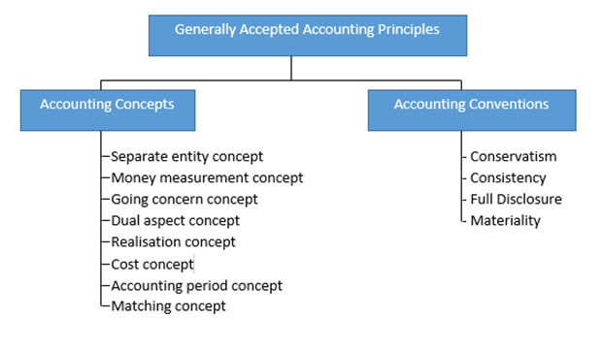

Slide 7
I) Accounting Concepts:
Separate Entity Concepts
The accountant keeps all of the business transactions of a sole proprietorship separate from the business owner's personal transactions. For legal purposes, a sole proprietorship and its owner are considered to be one entity, but for accounting purposes they are considered to be two separate entities.

Slide 8
Money Measurement Concepts:
This is the concept that a business should only record transactions that can be stated in terms of a unit of currency. Thus, it is easy enough to record the purchase of a fixed assets, since it was bought for a specific price, whereas the value of the quality control system of a business is not recorded. This concept keeps a business from engaging in an excessive level of estimation in deriving the value of its assets and liabilities.

Slide 9
3. Going Concern Concept:
This is the concept that a business will remain in operation for the foreseeable future. This means that you would be justified in deferring the recognition of some expenses, such as depreciation, until later periods. Otherwise, you would have to recognize all expenses at once and not defer any of them.

Slide 10
4. Cost Concepts:
This is the concept that a business should only record its assets, liabilities, and equity investments at their original purchase costs. This principle is becoming less valid, as a host of accounting standards are heading in the direction of adjusting assets and liabilities to their fair values.

Slide 11
Periodicity / Time Period Concept:
This is the concept that a business should report the results of its operations over a standard period of time. This may qualify as the most glaringly obvious of all accounting principles, but is intended to create a standard set of comparable periods, which is useful for trend analysis.

Slide 12
Matching Concept:
This is the concept that, when you record revenue, you should record all related expenses at the same time. Thus, you charge inventory to the cost of goods sold at the same time that you record revenue from the sale of those inventory items. This is a cornerstone of the accrual basis of accounting. The cash basis of accounting does not use the matching the principle.

Slide 13
Revenue Recognition / Reaslization Concept:
This is the concept that you should only recognize revenue when the business has substantially completed the earnings process. So many people have skirted around the fringes of this concept to commit reporting fraud that a variety of standard-setting bodies have developed a massive amount of information about what constitutes proper revenue recognition.

Slide 14
Accrual Concept:
This is the concept that accounting transactions should be recorded in the accounting periods when they actually occur, rather than in the periods when there are cash flows associated with them. This is the foundation of the accrual basis of accounting. For example, if you ignored the accrual principle, you would record an expense only when you paid for it, which might incorporate a lengthy delay caused by the payment terms for the associated supplier invoice.

Slide 15
Reliability / Objective Evidence Concept:
This is the concept that only those transactions that can be proven should be recorded. For example, a supplier invoice is solid evidence that an expense has been recorded. This concept is of prime interest to auditors, who are constantly in search of the evidence supporting transactions.

Slide 16
II) Accounting Conventions:
Consistency Concept:
  This is the concept that, once you adopt an accounting principle or method, you should continue to use it until a demonstrably better principle or method comes along. Not following the consistency principle means that a business could continually jump between different accounting treatments of its transactions that makes its long-term financial results extremely difficult to discern.

Slide 17
Full Disclosure Concept:
This is the concept that you should include in or alongside the financial statements of a business all of the information that may impact a reader's understanding of those statements. The accounting standards have greatly amplified upon this concept in specifying an enormous number of informational disclosures.

Slide 18
Conservatism Concepts:
This is the concept that you should record expenses and liabilities as soon as possible, but to record revenues and assets only when you are sure that they will occur. This introduces a conservative slant to the financial statements that may yield lower reported profits, since revenue and asset recognition may be delayed for some time. Conversely, this principle tends to encourage the recordation of losses earlier, rather than later.

Slide 19
Materiality Concepts:
This is the concept that you should record a transaction in the accounting records if not doing so might have altered the decision making process of someone reading the company's financial statements. This is quite a vague concept that is difficult to quantify, which has led some of the more picayune controllers to record even the smallest transactions.

Slide 20
Thank You

